Slide 1
A core Course on Modeling
Introduction to Modeling
0LAB0 0LBB0 0LCB0 0LDB0
c.w.a.m.v.overveld@tue.nl
v.a.j.borghuis@tue.nl
S.1

Slide 2
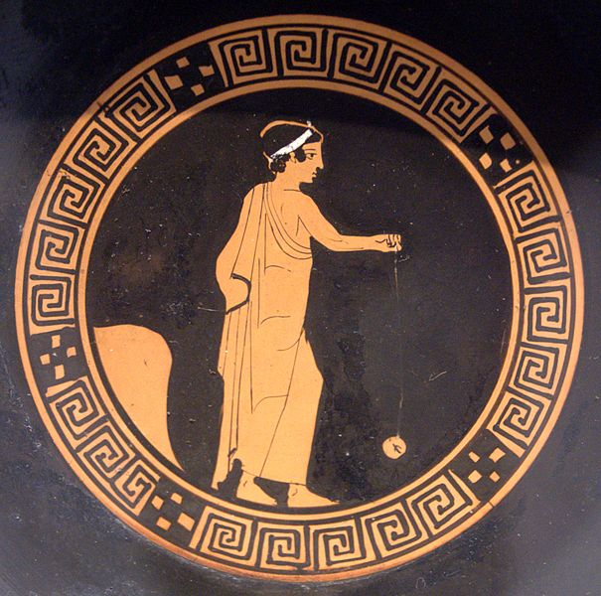
http://commons.wikimedia.org/wiki/File:Yo-yo_player_Antikensammlung_Berlin_F2549.jpg
Notes:
2
The best way to learn something, is to practice.
This truth has been known since ancient times. The Greek knew it, and it has been a guiding principle ever since.
Practicing is the way to develop mental competences, like foreign languages, poetry or modeling – which will be the topic of these lectures – just as well as motoric skills such as driving your bicycle, whistling on your fingers or playing the yoyo.
Talking of which.
Why not grab a piece of paper and a pen, and derive the mathematical model of a yoyo. I mean – like right here and now, as we speak. I reckon it should take you two minutes at most. Go ahead – I will wait.

Slide 3
Answer: μ_{JJ}=2μ_{D}+μ_{R}
http://commons.wikimedia.org/wiki/File:Yo-yo_player_Antikensammlung_Berlin_F2549.jpg
Notes:
3
OK – here is the answer: the mass of a yoyo is twice the mass of the disk plus the mass of the rope. Who of you got this result?
Nobody? How very strange – it seems obvious that this formula gives the mass of a yoyo, doesn’t it? So this model must be correct. I must say that I am a bit disappointed that none of you found it … What? What do you mean, cheating? I haven’t been cheating: I asked for the mathematical model of a yoyo, and that is what this is.
But perhaps you expected something else. Perhaps you thought of a model involving motions, translations and rotations? Maybe you thought of forces and torques, or even friction?
I didn’t say that your model should be used for calculating the motion of a yoyo, or the forces involved. Neither did I say that your model should help calculating the cost price of a yoyo, or how to manufacture or market it. In fact, I didn’t tell you any purpose at all for the mathematical model to be derived.
And this is precisely the source of your confusion: you tried making a model, but there was no clue of the purpose it should fulfill. So there was no way to tell if your model was in any sense correct, appropriate or adequate. And you therefore had no idea where to begin. Or at least: I hope that you did not begin. It would be a bit odd to start working on something without knowing the goal to fulfill, wouldn’t it? If you don’t know the purpose of what you are supposed to do, there are only two steps you can take: either find out or … do nothing.
Well – in this respect perhaps I was cheating: I gave you an instruction that you could not accomplish, and you couldn’t ask me for help.

Slide 4
No model
_{Without}
_{A purpose}
Answer: μ_{JJ}=2μ_{D}+μ_{R}
http://commons.wikimedia.org/wiki/File:Yo-yo_player_Antikensammlung_Berlin_F2549.jpg
Notes:
4
But this brings us to the first lesson. A model can never mean anything without a clear purpose. Before making a model, the purpose should be made explicit: what exactly is the model supposed to do for us? Also, when deploying an existing model the first question should be whether the purpose this model was built for is indeed the same as the purpose at hand – and if not, seek for another model.
These recommendations sound totally trivial – but they aren’t. The word ‘model’ is heavily abused, both in academic parlance and beyond. In all sorts of contexts, people constantly talk about X being a model for Y, without mentioning what X should do. Or even in what sense X relates to Y.
Perhaps you should pay attention, the forthcoming days, and notice when the word ‘model’ is used – and each time ask yourself what the possible purpose in this situation could be.
In order to do that, though, we need to better understand precisely what ‘purpose’ means. What purposes are there, and how do we find out the purpose of something? These are difficult questions, and we devote our next video to addressing them.

Slide 5
QUIZ
(some question)
press pauze to think
and resume after you have found the answer
http://commons.wikimedia.org/wiki/File:Labyrinth_vor_St._Lambertus,_Mingolsheim.JPG
Notes:
5
But this brings us to the first lesson. A model can never mean anything without a clear purpose. Before making a model, the purpose should be made explicit: what exactly is the model supposed to do for us? Also, when deploying an existing model the first question should be whether the purpose this model was built for is indeed the same as the purpose at hand – and if not, seek for another model.
These recommendations sound totally trivial – but they aren’t. The word ‘model’ is heavily abused, both in academic parlance and beyond. In all sorts of contexts, people constantly talk about X being a model for Y, without mentioning what X should do. Or even in what sense X relates to Y.
Perhaps you should pay attention, the forthcoming days, and notice when the word ‘model’ is used – and each time ask yourself what the possible purpose in this situation could be.
In order to do that, though, we need to better understand precisely what ‘purpose’ means. What purposes are there, and how do we find out the purpose of something? These are difficult questions, and we devote our next video to addressing them.

